Slide 1
UNIFIED MODELING LANGUAGE
(UML)

Slide 2
UNIFIED MODELING LANGUAGE (UML)
Unified Modeling Language was firstly published by the Object Management Group (OMG) in 1997 as an open and industry-standard visual modeling language.
Unified Modeling Language is a language for specifying, visualizing, constructing, and documenting the artifacts of software systems, as well as for business modeling and other non-software systems .
UML is a modeling language, not a programming language.
It provides graphical and semantical representations for object-oriented software design.

Slide 3
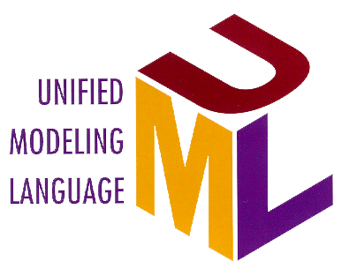
Inputs to UML
Booch
Rumbaugh
Jacobson
Meyer
Fusion
Before and after
conditions
Operation descriptions,
Message numbering
Embley
Harel
Singleton classes,
High-level view
State charts
Gamma, et.al
Wirfs-Brock
Frameworks, patterns,
notes
Responsibilities
Shlaer - Mellor
Odell
Object Lifecycles
Classification
Notes:
UML development included incorporating ideas from numerous other methodologists. The main challenge was constructing an approach that was simple yet allowed the modeling of a broad range of systems. The conceptual framework was established quickly but the notational semantics took more time.
Active collaboration with other industry leaders has brought unique expertise and experience into the UML effort. The UML effort was supported by a large cross-section of the industry. Partners in the UML effort included HP, ICON Computing, IBM, I-Logix, Intellicorp, MCI Systemhouse, Microsoft, ObjecTime, Oracle, Platinum Technology, Ptech, Reich Technologies, Softeam, Sterling Software, Taskon, and Unisys. These partners provided contributors, reviewers, and advocates for the standardization efforts.
In the end, a modeling language was created that has already stood up to the test of widespread use in the industry and to the scrutiny of international standardization efforts.
Again, this is a slide you do not need to spend a lot of time on. You might just want to point out one or two contributors of special interest to your audience. For example, for a telephony audience, you might point out Harel and his state charts.

Slide 4
EVOLUTION OF UML
There are three methods of UML.
The Booch Method: It was developed by Grady Booch.
  This approach was excellent for design and implementation of projects. Booch was a primary player in the development of object-oriented technique and primarily he was working in Ada language.
The OMT (Object Modeling Technique): This technique was explored by J. Rambaugh et al.
  This was most suitable for analysis and data intensive information systems.
The Objectory: This is an object-oriented software engineering approach and it was developed by Ivar Jacobson.
  This method uses use cases for understanding the behavior of a system. This method is useful in requirements capturing, analysis, and high-level designs.

Slide 5
UML History
Year Version
2003: UML 2.0
2001: UML 1.4
1999: UML 1.3
1997: UML 1.0, 1.1
1996: UML 0.9 & 0.91
1995: Unified Method 0.8
Booch ‘93
OMT - 2
Other methods
Booch ‘91
OMT - 1
Notes:
The UML is now the industry standard modeling language. Its development was spearheaded by three leaders in the object-oriented industry: Grady Booch, Ivar Jacobson, and Jim Rumbaugh. Each of them had unique approaches in the early 1990s that were converging independently. Rational Software brought these three industry leaders together to accelerate convergence to a single modeling approach. The UML is the outcome of that effort.
The UML has been under development since 1990. Early versions have gradually converged into the UML standard 1.1 that was adopted unanimously by the OMG in November 1997. Numerous books, articles, and papers have been written about or are using the UML today and many more are to come. And finally, most tool vendors today are supporting the UML.
Version 1.3 of the UML is under development at the present time.
In many cases, the students will already be familiar with this history. Therefore, it is not necessary to spend a lot of time on this slide. The points to make are:
1. Rational provided the leadership to make this happen.
2. Rational did not do this in a secret or proprietary way. Everyone had their say and many companies made significant contributions.
3. UML is a standard and will evolve under the supervision of the OMG.
Version 1.3 is currently expected to be adopted in October 1998.

Slide 6
UML Tools
Current Version: UML 2.2
  Information at the OMG portal http://www.uml.org/
Commercial tools: Rational (IBM),Together (Borland), Visual Architect (business processes, BCD)
Open Source tools: ArgoUML, StarUML, Umbrello, Microsoft Visio, Visual Paradigm etc.
Commercial and Opensource: PoseidonUML (Gentleware)

Slide 7
Conceptual Model of UML
Encompasses three major elements:
  Basic building blocks
  Rules
  Common mechanisms

Slide 8
UML BUILDING BLOCKS
The three building blocks of UML are:
  Things
  Relationships
  Diagrams

Slide 9
Things
There are four kinds of things in UML, namely:
  Structural Things : These are the nouns of the UML models representing the static elements that may be either physical or conceptual. The structural things are class, interface, collaboration, use case, active class, components, and nodes.
  Behavioral Things : These are the verbs of the UML models representing the dynamic behavior over time and space. The two types of behavioral things are interaction and state machine.
  Grouping Things : They comprise the organizational parts of the UML models. There is only one kind of grouping thing, i.e., package.
  Annotational Things : These are the explanations in the UML models representing the comments applied to describe elements.

Slide 10
Relationships
The four types of relationships that can be represented in UML are:
  Dependency
  Association
  Generalization
  Realization

Slide 11
Diagrams
A diagram is a graphical representation of a system. UML includes nine diagrams in all, namely:
  Class Diagram
  Object Diagram
  Use Case Diagram
  Sequence Diagram
  Collaboration Diagram
  State Chart Diagram
  Activity Diagram
  Component Diagram
  Deployment Diagram

Slide 12
Rules
UML has a number of rules so that the models are semantically self-consistent and related to other models in the system harmoniously.
UML has semantic rules for the following:
  Names
  Scope
  Visibility
  Integrity
  Execution

Slide 13
Common mechanisms
UML has four common mechanisms:
  Specifications: In UML, behind each graphical notation, there is a textual statement denoting the syntax and semantics.
  Adornments: Each element in UML has a unique graphical notation. Besides, there are notations to represent the important aspects of an element like name, scope, visibility, etc.
  Common Divisions: Object-oriented systems can be divided as, Division of classes and objects; and Division of Interface and Implementation
  Extensibility Mechanisms: The extensibility mechanisms are: Stereotypes, Tagged Values, Constraints

Slide 14
USE CASE
UML modeling uses abstraction for the representation of the behavior of a system, which is shown by use case.
A use case represents a set of functions performed by a system for a specific goal.
A use case does not describe the implementation details. Use cases can be implemented by several users.
Each user may use the system for a different purpose. The system functionalities are decomposed into sub-functions and these are represented by use cases.
Use case is a logical description of system functionality. Actors and use cases are connected by solid lines.
A use case is drawn as an ellipse and labelled with its name inside it.

Slide 15
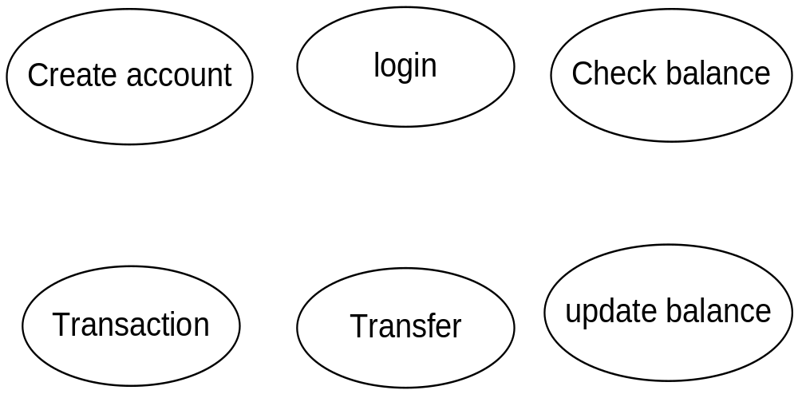
USE CASE EXAMPLES

Slide 16
ACTOR
Actors can be the user of the system or other external events.
An actor may play different roles in systems and hence it may interact with several use cases.
A use case can be initiated by various actors. But each actor has a unique name and description.
Actors are represented by their roles.
An actor is represented as a small stick person labelled with its name

Slide 17
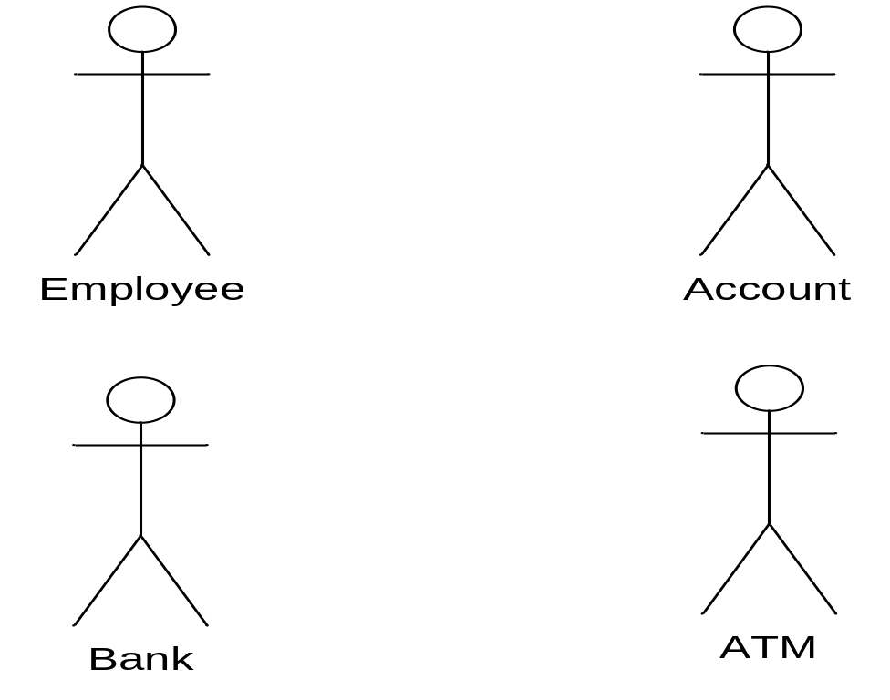
ACTOR
some examples of actors are as follows:

Slide 18
CLASS
A class defines the static structure of an object. It includes the attributes and the methods of an object.
All objects of a class have the same attributes and behavior.
All objects can be distinguished with their attributes. Classes are represented by rectangles which have three compartments.
The upper part represents the class name; the second part is used for attributes; and the last part is used for operation specifications.
Attributes and operations are specified with their data type. The parameters can be specified in the operations

Slide 19
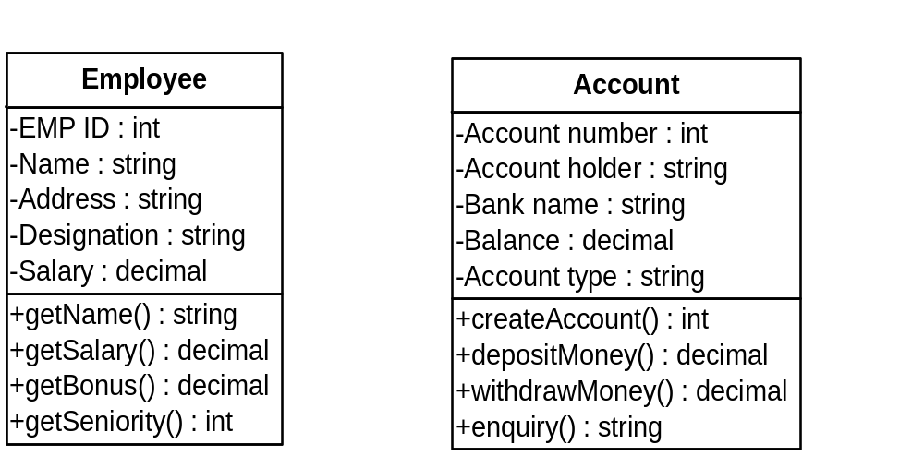
CLASS
Some examples are as follows:

Slide 20
Pure virtual functions
A pure virtual function in C++ is a virtual function declared in a base class that has no required implementation in that class and must be overridden by derived classes to make them concrete.

Slide 21
#include <iostream>
using namespace std;
class Shape {
public:
virtual void draw() = 0;
};
class Circle : public Shape {
public:
void draw() override {
cout << "Drawing a Circle";
} }
int main() {
Circle c;
c.draw();
return 0;}
The output will be :
Drawing a Circle

Slide 22
INTERFACE
An interface defines communication socket to connect with another class.
It contains a set of operations that a class provides to the other classes.
Generally, interfaces are implemented through abstract classes in which services of a class are defined. An interface does not contain attributes.
An interface is shown as a class with the interface stereotype written on it.
An interface is a blueprint that defines a set of methods and constants that a class can implement.
Sometimes, type stereotype is also used for the representation of an interface.
It has only the operations that will be implemented by other classes.
A circle notation is also used to represent the interface with a solid line to the class that supports it.
In C++, it is specified by pure virtual functions.

Slide 23
INTERFACE
Example of interface:-
interface Animal {
void sound();
}
class Dog implements Animal {
public void sound() {
System.out.println("Dog barks");
}
}

Slide 24
INTERFACE
Here:
Animal is an interface.
sound() is a method declared in the interface.
Dog implements the Animal interface.
The Dog class provides the implementation of sound().
The output will be Dog barks.

Slide 25
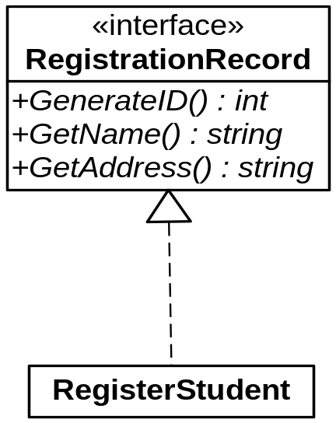
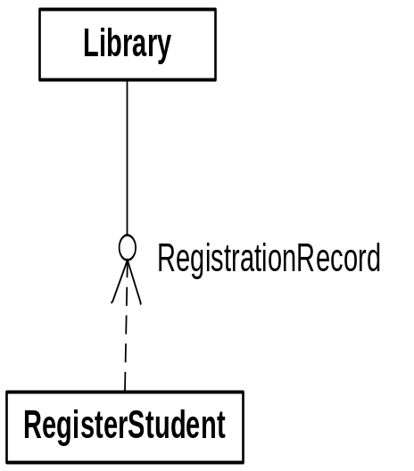
INTERFACE
For example, RegistrationRecord class can be used by the RegisterStudent class for registration in the library.
RegistrationRecord is supported by the Library class.
Student registration is possible through this interface that the library is using for registration.

Slide 26
COMPONENT
A component is an independent unit of execution. It is a piece of software that implements a number of interfaces.
Components are implementation in the physical architecture of the concepts that are replaceable in the system.
A component provides its services to other components. A component instance has a name and a type.
Components can be programs, DLLs, runtime linkable images, and so on.
A component is shown as a rectangle with two small rectangles protruding from its side.

Slide 27
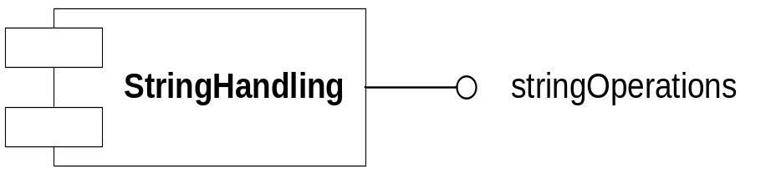
COMPONENT
For example, the StringHandling component performs string operations that will implement stringOperations interface.

Slide 28
PACKAGE
A package is used to represent the modular view of a system.
A package represents the part of a system which contains several classes and it may in turn also contain other packages.
Packages are conceptual groupings of the system and need not necessarily be implemented as cohesive software modules.
These are used to combine classes, components, nodes, and other UML constructs. As a package consists of other constructs, there exist dependencies among them.
A package is drawn as a rectangle with tabs on it. Dependencies are shown as dashed arrows.

Slide 29
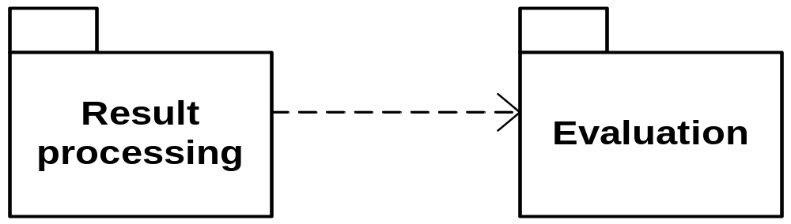
PACKAGE
For example, the Result processing package depends on the Evaluation package.

Slide 30
NODE
A node is a physical object that can execute artifacts.
It exists at run time and represents computational resources such as memory and processing units.
Nodes can vary in size and capability, from a simple embedded device to a server form.
Nodes are used in deployment diagrams. They show how programs flow during their runtime environment and at what device program is to be executed.
Nodes are especially identified in the component development environment such as J2EE, .NET, etc.
A node is shown as a stylized cube with the name of the node.

Slide 31
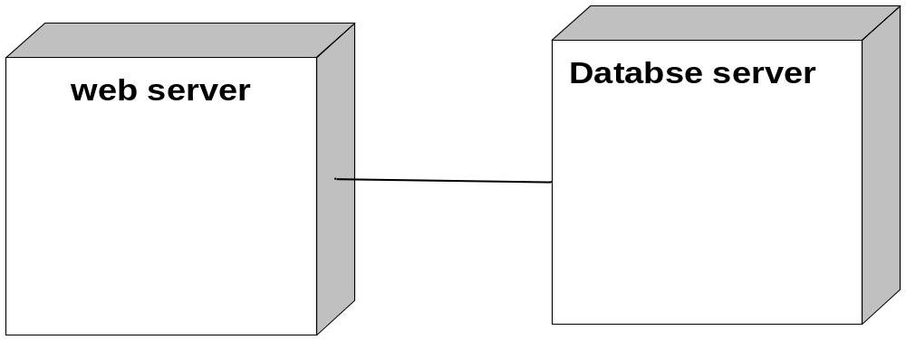
NODE
For example, a Web server running in a remote location can access Database server, as it is shown below.

Slide 32
COLLABORATION
Collaboration is the organization of various objects to realize the behavior in a context.
It also represents the interaction between software objects.
It illustrates messages being sent between classes and objects (instances).
All the objects and their relations are wired together using connectors to show the communication flow.

Slide 33
COLLABORATION
Collaboration in UML (Unified Modeling Language) represents how a group of objects or components work together to accomplish a specific task or achieve a common goal.
It shows the relationships between objects and how they interact by exchanging messages to perform a particular function.
Collaboration is commonly represented using a Communication Diagram (formerly called a Collaboration Diagram) in UML.

Slide 34
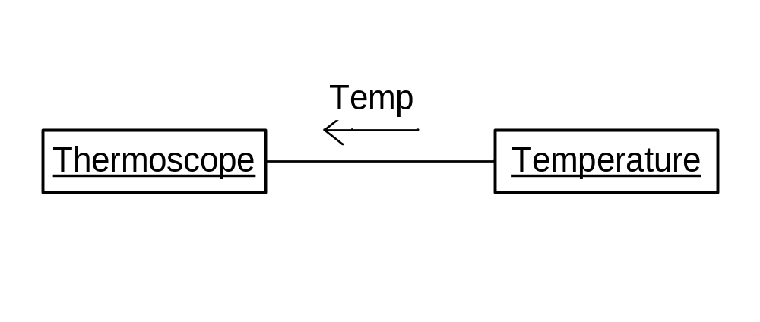
COLLABORATION
Collaboration is shown as a rectangle with the object name. For example, Temperature is recorded through the Thermoscope device.

Slide 35
INTERACTION
Interaction in UML (Unified Modeling Language) represents the communication between objects or components of a system to perform a particular task with respect to time.
It describes how objects exchange messages and work together to achieve a specific goal.
The purpose of interaction is to show the messages exchanged among objects.
Each message is exchanged between objects in a specified context.
Interaction represents the dynamic behaviour of the system.
It shows the flow of control across objects.
It is represented by an arrow with the message name exchanged between the objects and it is shown as follows.

Slide 36
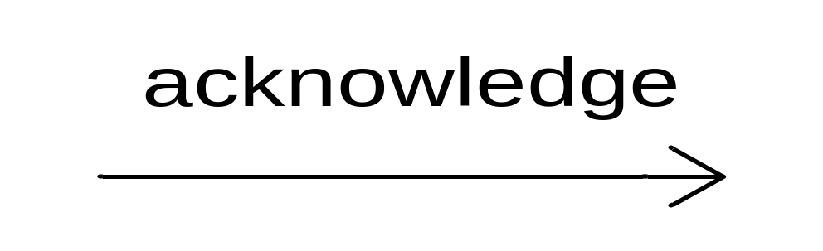
INTERACTION EXAMPLE

Slide 37
STATE MACHINE
A State Machine Diagram in UML (Unified Modeling Language) is a behavioural diagram that represents the different states of an object and the transitions between those states in response to events.
It describes how an object changes its behaviour or state during its lifetime.
State machine represents the behaviour of an object during its lifetime.
The state machine describes the single snapshot of the execution of a system where objects interact with each other.
The state machine has events and states.
A state is drawn as a rectangle with rounded corners. The transitions between states are shown through arrows with the actions performed by objects.

Slide 38
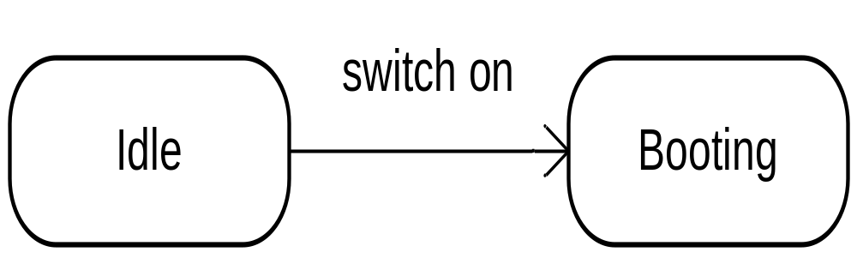
STATE MACHINE
The following example shows the state machine in which an Idle computer machine moves to the Booting state as you switch it on.

Slide 39
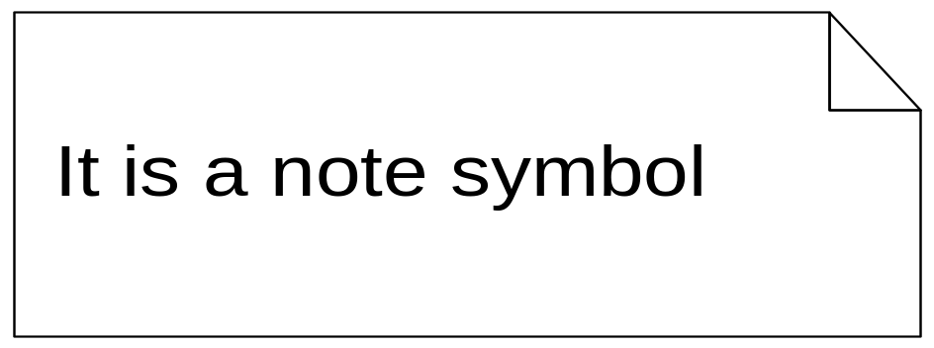
NOTE
A note is used to provide comments. Textual information such as a comment, constraint definition, or method body in UML diagrams can be described through notes.
Notes are depicted by a rectangle with the top-right corner folded over.
A note is illustrated as follows.

